Slide 1
HIL PDR
2/19/2020
Alex Necakov, Ryuichi Ohhata

Slide 2
System Overview

Slide 3
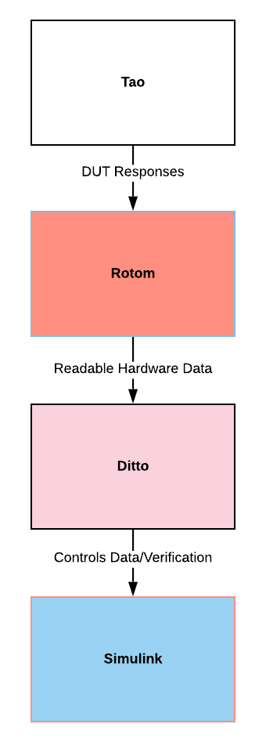




Updated System Architecture
Device under test (DUT) design for testing
HIL connector on ASTRo test board
FPGA (Rotom) pass through between Ditto and DUT
For allowing specific protocols to work (I2C, PWM)
Main microcontroller (Ditto) communicates between DUT and Simulink
Responsible for loading Slave-side drivers
Also responsible for sending feedback and model responses along system
Simulink integration of the Aero model
Allows simulation of realistic flight data
Communicates over Serial packets to Ditto

Slide 4
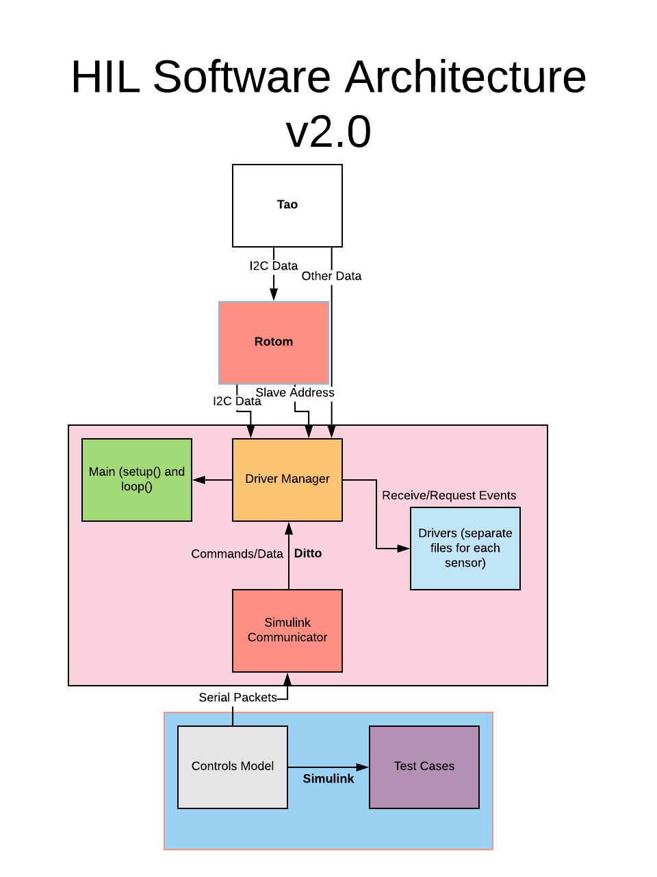
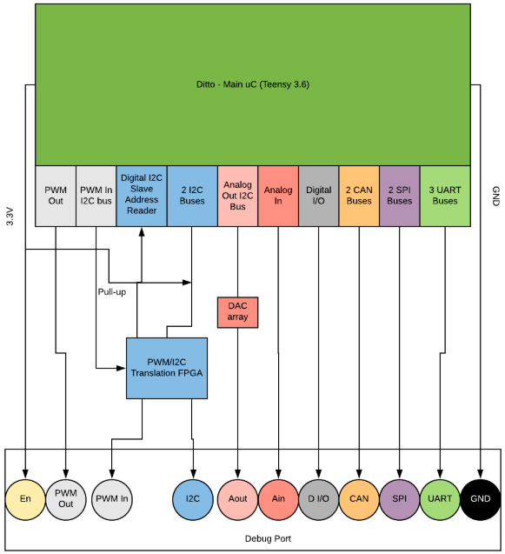
Software and Hardware Architecture

Slide 5
DUT Integration

Slide 6
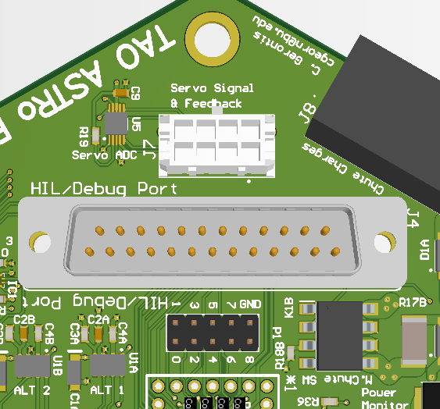
DUT - DUT side HIL Connection
Connect DUT to HIL system over built in connector
D-Sub male port on ASTRo avionics
Allows connection to many ports in one socket
Different DUTs will have different pinout and number of connections
Any size D-Sub could be used on various DUTs
Enable pin on the D-Sub will control Bus Switches on DUT
When enabled, these switch connection between Tao’s uC and sensors to the HIL system

Slide 7
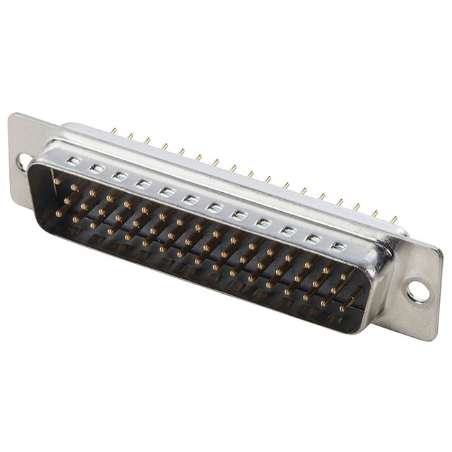
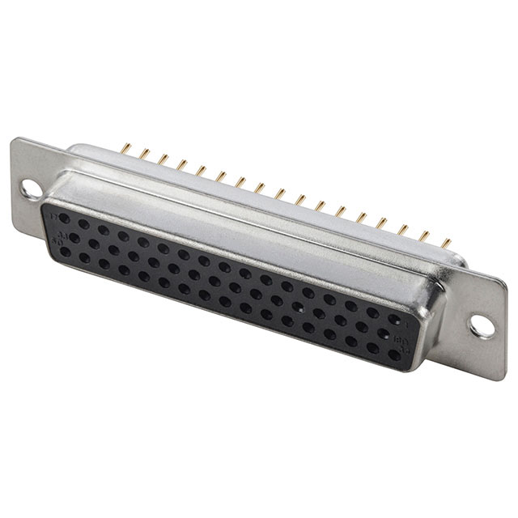
DUT - Ditto side HIL connector
Larger D-Sub connector
Looking at 50 pin models currently from Assmann Components
$3.34 for Male
$2.84 for Female
Map each (useful) pin of Ditto to connector
Connector pins can be remapped to different configurations to use different buses of Ditto
Adapters will be made to map pins from large connector to DUT side connector

Slide 8
DUT - Buses needed for HIL on current systems
ASTRo
I2C - needed for sensors and servo module
Current development has all been towards I2C
Test implementation succeeded
Pursuit
UART - needed for communication between Tao microcontrollers
Not developed yet, will be worked on after system is more mature/testing of inter-uC communication is actually in development

Slide 9
FPGA Implementation

Slide 10
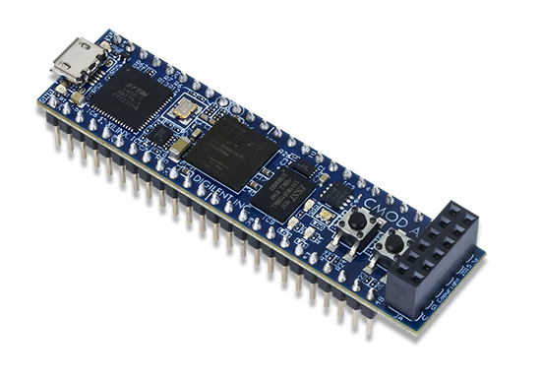
Rotom - FPGA choice overview
FPGA in-between HIL connector and Ditto
Intercepts signals on I2C and PWM buses
Needed primarily for emulation of multiple I2C Slave Addresses on one uC
Using Xilinx board as ECE students at BU are trained on them with the Vivado IDE
We get Vivado for free
Cmod A7 being used as we already have one available here

Slide 11
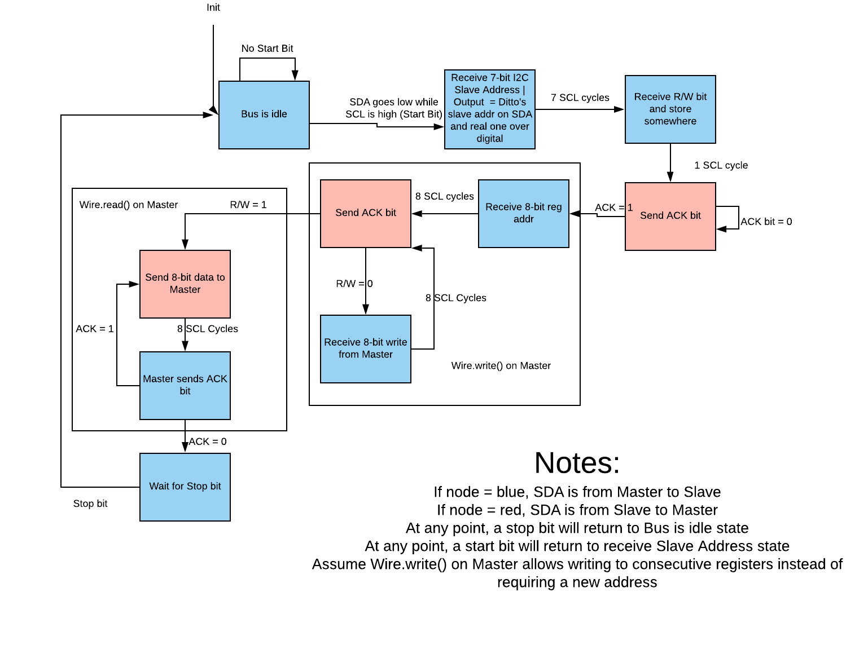
Rotom - I2C Module
I2C Address module has been built and verified on testbench
Stinos will be working on verifying module on hardware shortly

Slide 12
Microcontroller and Software

Slide 13
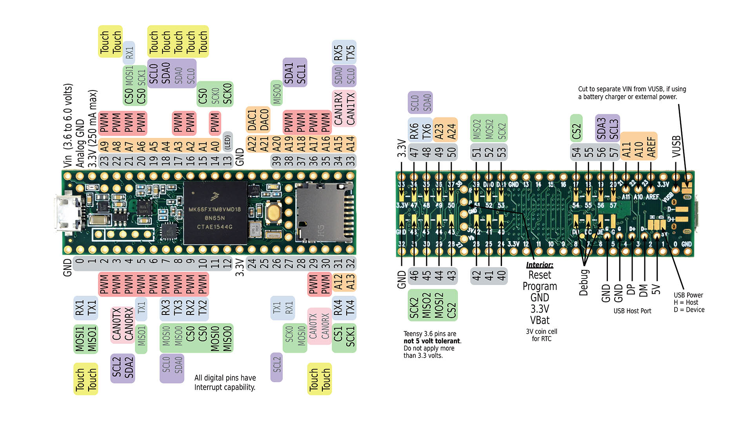
Ditto - Microcontroller Overview
Still using Teensy 3.6 as main uC
Tons of GPIO
4 I2C buses
3 SPI buses
6 Serial Ports
Lots of Ain
Two onboard DACs

Slide 14
Ditto - Driver Manager and drivers
Loads drivers in to handle receive and request events
Case based system that keeps track of messages sent from DUT
Uses I2C address from Rotom to determine which device to spoof
Individual Slave-side drivers for each sensor based on the DUT drivers

Slide 15
Ditto - Driver Manager Current Status
Driver Manager prototype done
Several drivers developed but need testing
MPL3115A2 - Altimeter
BNO055 - IMU
BMP388 - Altimeter
MCP9600 - TC Amp
Full hardware test of drivers is reliant on Rotom succeeding testing

Slide 16
Ditto - Simulink Communicator
Receive 3 byte Serial commands from Simulink
Mimics I2C communication for easy use with existing drivers
Device Address - Register Address - Register Data
I2C reserved addresses are being used for command functions (adding drivers, rebooting, etc)
Send data from Simulink and return response from DUT
Interprets signals to send to driver manager and other parts of Ditto software

Slide 17
Ditto - Simulink Communicator Current Status
Able to successfully send and receive data from Simulink
Working on testing real-time operation of Simulink communication
Need to build out integration with Driver Manager

Slide 18
Simulink Integration

Slide 19
Simulink - Controls Model Implementation
Build custom functions in MATLAB to communicate over Serial to Ditto
Implements functions within a modified version of the controls model
MATLAB function blocks are made for each area of the model that requires input
Require more complete Aero model/communication with Zach to do full integration
Also reliant on building out actuator drivers to determine responses

Slide 20
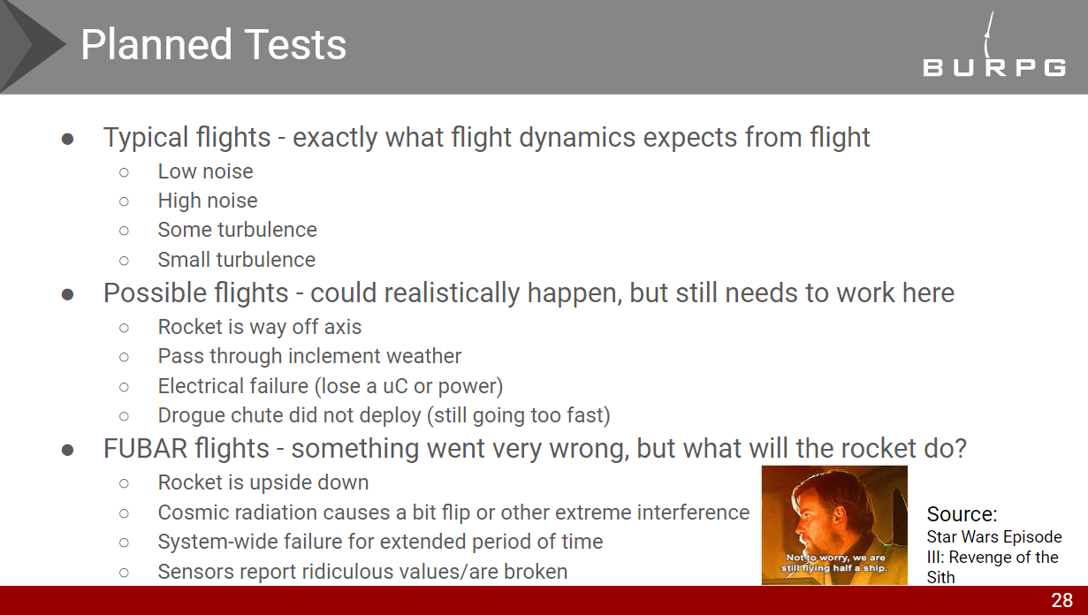
Simulink - Simulink Test
Simulink Test lets us build out test cases with the controls model
Allows measuring of test failure or success
Awaiting full controls model implementation to begin
Source: HIL CoDR

Slide 21
New HIL Roadmap
Test I2C Slave Address module on Rotom
Test Driver Manager
Single driver for each driver
Connection with Simulink Communicator
Multiple drivers with Rotom
All ASTRo necessary drivers
Write more Slave drivers
Build out Simulink Communicator
Determine commands for all required sensors on ASTRo
Customize function blocks for each sensor
Talk to Zach more about the actual model and Esther about how it will be implemented on DUT
Design HIL hardware
Finalize Ditto and Rotom pinout
Design PCB to hold Ditto, Rotom, and the D-Sub connector
Design adapter board for ASTRo
Work on Simulink Test
This will be after the rest of the system is more developed

Slide 22
Questions?

